Slide 1




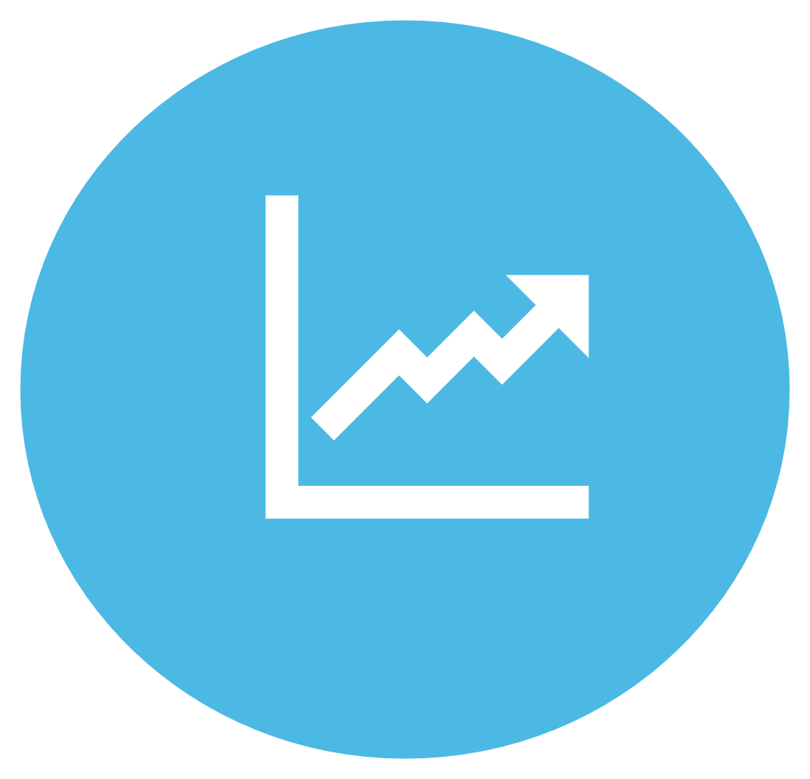
CALCULATIONS
COMBINATIONS
ANALYZE
Notes:
Hello everyone. Today, I am excited to share with you a project that I have been working on to improve my skill in the field of data science. It is a project that combines my interest in poker with my passion for data and the result is the Shark Poker Bot.
Before we get started, note that any ready-made code or dataset was not used in this project.
Throughout this presentation, I will walk you through the development process of the Shark Poker Bot, from the dataset creation to the implementation of the machine learning algorithms and let's dive into the world of the Shark Poker Bot.

Slide 2

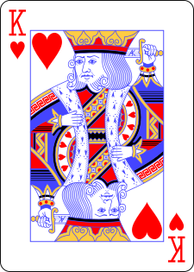
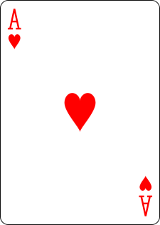
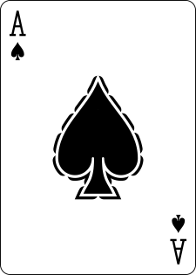
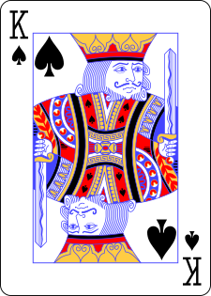
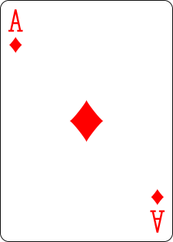
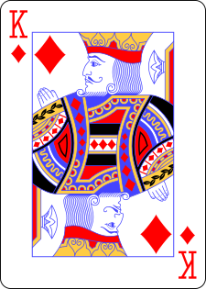
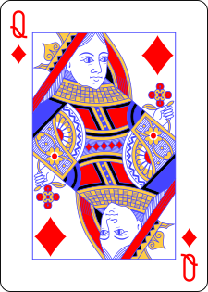
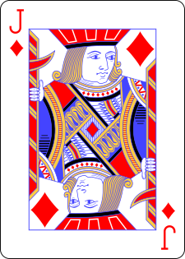
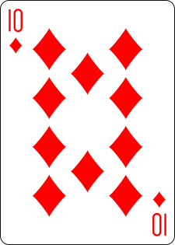
Trillion
Billion
Million
Thousand
Hundred
2.
781.
381.
002.
400
Deal 9 cards every second, it would take you more then 80 years
Community cards
Notes:
When two players sit down to play, each player is dealt two cards, and five more cards are dealt to the middle of the table. The total number of possible combinations of 9 cards that can be drawn from a deck of 52 cards is a staggering 2 trillion 781 billion 381 million 2 thousand 400.
If you were to deal 9 cards every second, it would take you more then 80 years to go through all possible combinations.
Now let's see how shark poker solved this problem.

Slide 3




CALCULATIONS
Notes:
The Shark Poker Bot makes calculations based on three different stages of the game: pre-flop, flop, turn, and river.

Slide 4
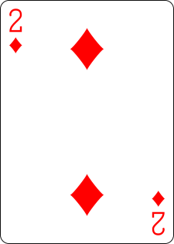
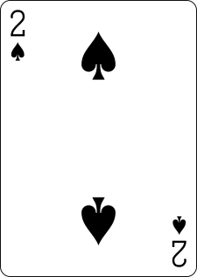
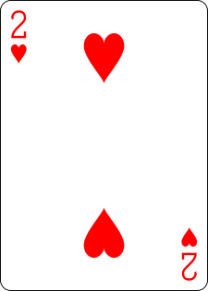
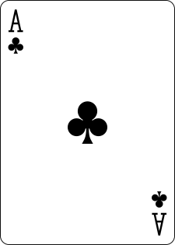
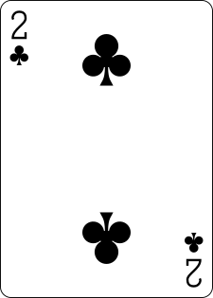
Pre-Flop Status
n choose k = n! / (k! * (n-k)!)
52 choose 2 = 52! / (2! * (52 - 2)!) = 1326
169
1326
Notes:
Pre Flop scenario:
There are 1,326 possible combinations of 2 cards out of a deck of 52, which is the number of possible pre-flop hands in poker.
We can eliminate equivalent combinations to reduce the 1,326 possible pre-flop hands in poker to 169 unique hands. For example, Ace of diamonds and 2 of diamonds is equivalent to Ace of hearts and 2 of hearts.

Slide 5
Flop Status
25,989,600
305,553
(52 choose 2) * (50 choose 3)= 25,989,600
Notes:
In a flop scenario, the Shark Poker Bot needs to consider 52 choose 2 possible combinations for its own hand and 50 choose 3 possible combinations for the community cards, amounting to around 29 million total combinations. To determine the strength of its hand, the bot must simulate every possible combination of community cards and opponent hands, which can be a daunting task.
To reduce the number of combinations, Shark Poker Bot uses a method that takes advantage of certain characteristics of the game. For instance, in the example shown on the slide, the bot's hand consists of two cards, while the other three cards are community cards. Notice that among the five cards on the board, there are no three cards of the same suit, making it impossible for the bot to have a flush, royal flush, or straight flush. As a result, the bot only needs to consider the rank values of the cards, rather than their suits.
in addition, the bot has also analyzed all possible combinations of the three community cards to determine which ones are equivalent to each other based on their suit combinations. For instance, it considers cases where all three cards are of the same suit, or where two of them are of the same suit and the third one is of a different suit. By doing so, the bot has reduced the total number of possible combinations that need to be simulated, allowing for a more efficient and effective decision-making process. With this reduction method, the bot has been able to decrease the total number of combinations to simulate from 29 million to around 300,000. More details on this reduction method can be found on the GitHub link.

Slide 6

Turn & River
For pre-flop and flop situations, a dataset of 300,000 rows was created through 30 billion simulations, with each combination tested in 100,000 different scenarios.
Notes:
Turn and river scenario:
One of the remarkable things about the Shark Poker bot is that it can perform real-time calculations during the turn and river stages of the game without relying on a pre-existing dataset. However, for the pre-flop and flop stages, the bot did require a massive dataset to operate accurately. To generate this dataset, over 30 billion simulations were run. The end result was a dataset of 300 thousand rows, allowing for precise predictions during these stages of the game.
In the next phase of the project, we will analyze the accuracy of this dataset and work to refine it further.

Slide 7
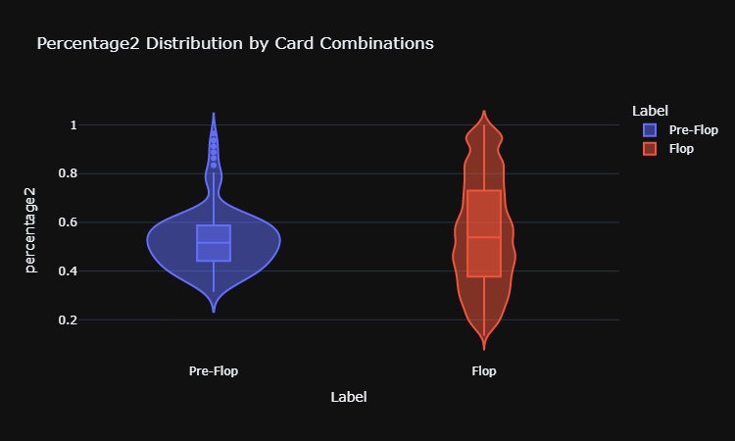
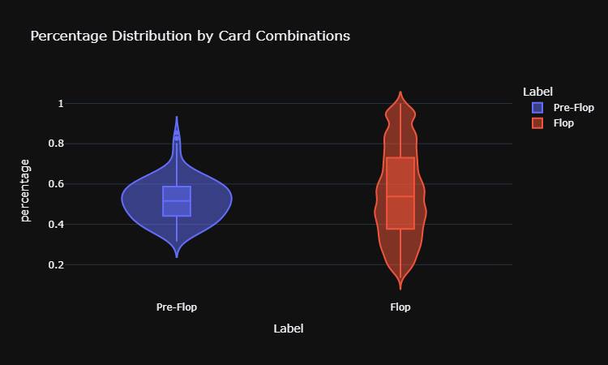
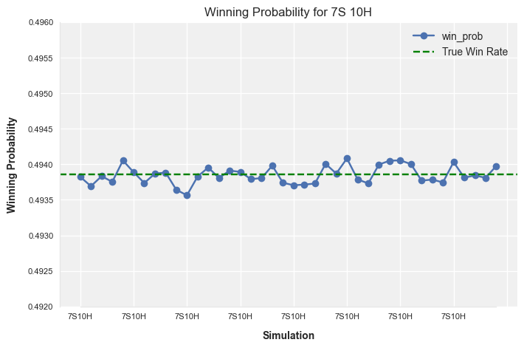
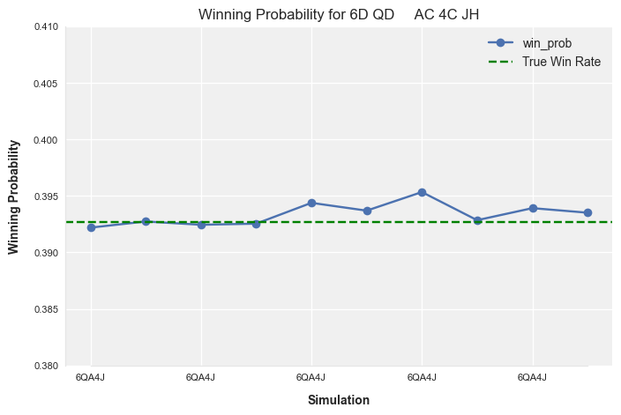
Pre-Flop vs Flop
Pre-Flop
Flop
Mean: 0.3934
Standard deviation: 0.0009
Minimum: 0.3922
Maximum: 0.3953
Median: 0.3932
Real:0.39265233962909424
Mean: 0.4938
Standard deviation: 0.0001
Minimum: 0.4936
Maximum: 0.4941
Median: 0.4938
Real:0.4938546659938889
Notes:
Shark Poker, has been designed to excel at calculating the odds of winning a hand. By performing almost 2 billion simulations for pre-flop status, the bot has achieved an incredibly high level of accuracy in predicting the outcome of a hand. This is reflected in the chart and statistics have provided, which show the winning probability for the 7 of spade and 10 of Hearts hand across multiple simulations.
In addition to the chart, you can also see calculated important statistics.
The provided chart and statistics demonstrate the consistency of the bot's calculations, providing players with invaluable insights into the strengths and weaknesses of different hands.
Now I will be explaining a table that shows the winning probabilities of cards in pre-flop and flop situations in a created dataset. As you can see, the winning probability is less than 80% in pre-flop scenarios.
However, to avoid inconsistency in shark poker machine learning, some winning probabilities have been manipulated in certain pre-flop situations to create this table.

Slide 8

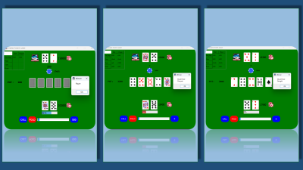
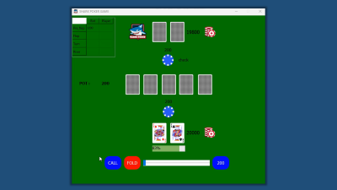
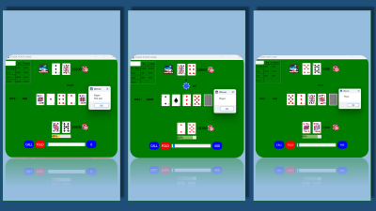



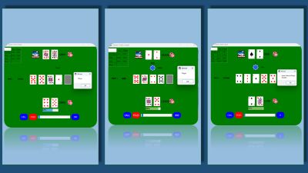

SHARK POKER
Notes:
Finally, Shark Poker Bot's decisions to continue, fold, or raise are based on parameters like opponent decision, pot amount, and opponent bet amount. The bot uses a machine learning algorithm trained on my created dataset to make these decisions, adapting to different scenarios and learning from past experiences. As a result, the bot can make intelligent and strategic decisions, increasing its chances of winning.
In conclusion, I am grateful for the opportunity to share my passion for data science. I believe this field is at the forefront of technological innovation, and I am eager to explore its vast opportunities and work with cutting-edge technologies to solve real-world problems. I am excited to take the next step in my career and make meaningful contributions to any organization I work for. Thank you for listening.
In the next part of the video, you can enjoy the music and review the poker sample games.

Slide 9
SHARK POKER
Notes:
Finally, Shark Poker Bot makes its decisions about continuing the game, folding, or raising the bet based on the parameters such as the opponent's decision, the pot amount, and the opponent's bet amount, using a machine learning algorithm that was trained on the dataset I created. This process allowed the bot to learn from past experiences and adapt to different scenarios that may arise during a game of poker. As a result, the Shark Poker Bot is able to make intelligent and strategic decisions that can lead to a higher chance of winning the game.
Thank you all for listening. As you have seen, my project is a testament to my passion and eagerness to pursue a career in data science. I believe that this field is at the forefront of technological innovation, and I am thrilled to be a part of it.
Throughout my journey in creating this project, I have gained valuable skills and knowledge that have equipped me with the tools necessary to thrive in this exciting field. I am confident that I have the necessary skills, dedication, and drive to excel in any data science role.
I am excited to explore the vast opportunities that exist in this field and to work with cutting-edge technologies to tackle real-world problems. I believe that with my strong analytical skills, problem-solving abilities, and critical thinking, I can make a significant impact in any organization.
To conclude, I am grateful for the opportunity to share my passion for data science with you today. I am eager to take the next step in my career and make meaningful contributions to any organization I work for. Thank you.

Slide 10
SHARK POKER
Notes:
Finally, Shark Poker Bot makes its decisions about continuing the game, folding, or raising the bet based on the parameters such as the opponent's decision, the pot amount, and the opponent's bet amount, using a machine learning algorithm that was trained on the dataset I created. This process allowed the bot to learn from past experiences and adapt to different scenarios that may arise during a game of poker. As a result, the Shark Poker Bot is able to make intelligent and strategic decisions that can lead to a higher chance of winning the game.
Thank you all for listening. As you have seen, my project is a testament to my passion and eagerness to pursue a career in data science. I believe that this field is at the forefront of technological innovation, and I am thrilled to be a part of it.
Throughout my journey in creating this project, I have gained valuable skills and knowledge that have equipped me with the tools necessary to thrive in this exciting field. I am confident that I have the necessary skills, dedication, and drive to excel in any data science role.
I am excited to explore the vast opportunities that exist in this field and to work with cutting-edge technologies to tackle real-world problems. I believe that with my strong analytical skills, problem-solving abilities, and critical thinking, I can make a significant impact in any organization.
To conclude, I am grateful for the opportunity to share my passion for data science with you today. I am eager to take the next step in my career and make meaningful contributions to any organization I work for. Thank you.

Slide 11
SHARK POKER
Notes:
Finally, Shark Poker Bot makes its decisions about continuing the game, folding, or raising the bet based on the parameters such as the opponent's decision, the pot amount, and the opponent's bet amount, using a machine learning algorithm that was trained on the dataset I created. This process allowed the bot to learn from past experiences and adapt to different scenarios that may arise during a game of poker. As a result, the Shark Poker Bot is able to make intelligent and strategic decisions that can lead to a higher chance of winning the game.
Thank you all for listening. As you have seen, my project is a testament to my passion and eagerness to pursue a career in data science. I believe that this field is at the forefront of technological innovation, and I am thrilled to be a part of it.
Throughout my journey in creating this project, I have gained valuable skills and knowledge that have equipped me with the tools necessary to thrive in this exciting field. I am confident that I have the necessary skills, dedication, and drive to excel in any data science role.
I am excited to explore the vast opportunities that exist in this field and to work with cutting-edge technologies to tackle real-world problems. I believe that with my strong analytical skills, problem-solving abilities, and critical thinking, I can make a significant impact in any organization.
To conclude, I am grateful for the opportunity to share my passion for data science with you today. I am eager to take the next step in my career and make meaningful contributions to any organization I work for. Thank you.

Slide 12
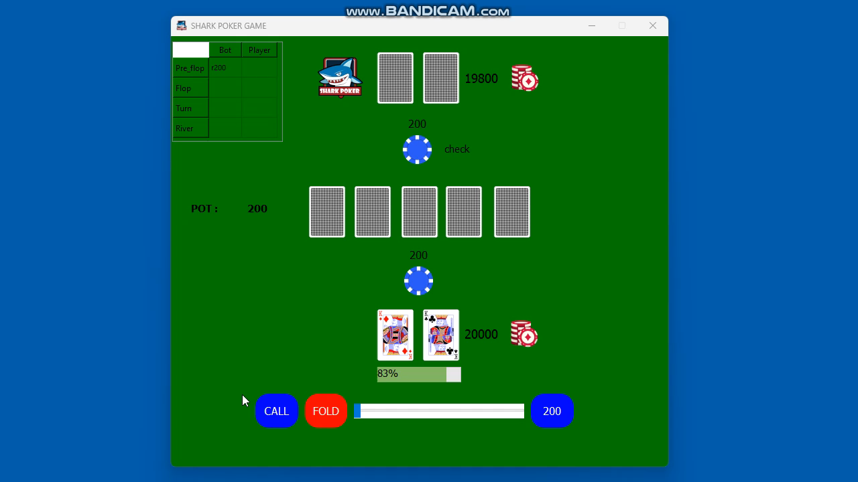

Slide 13
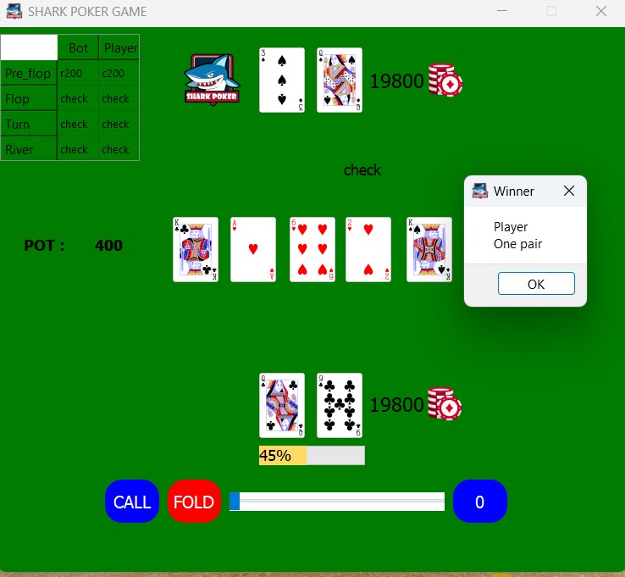
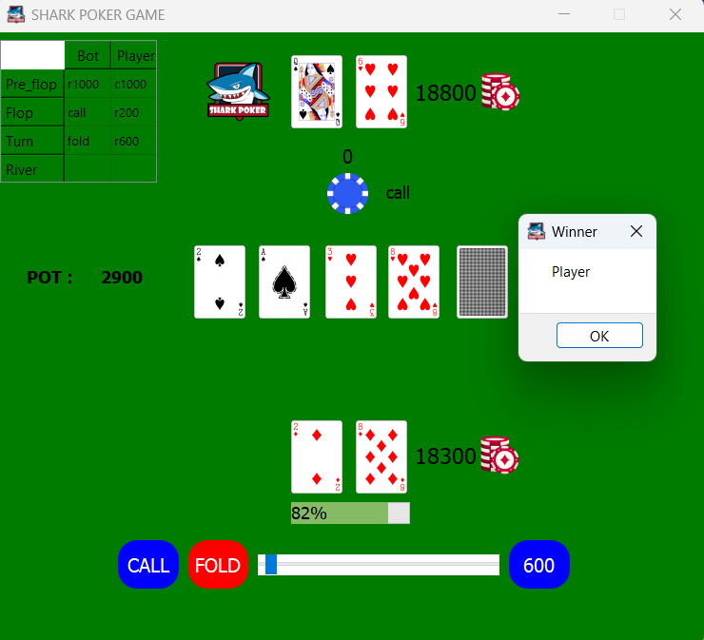
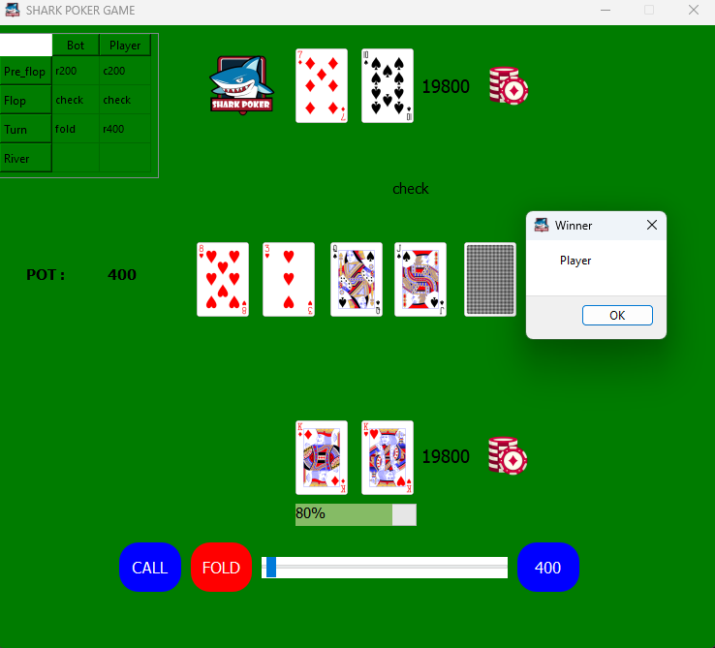

Slide 14
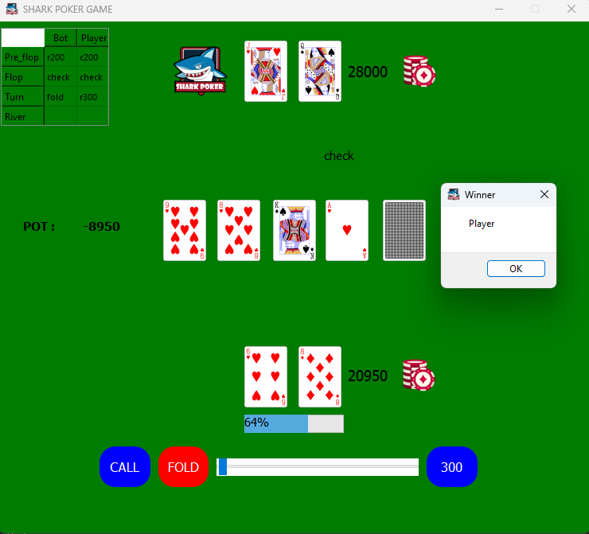
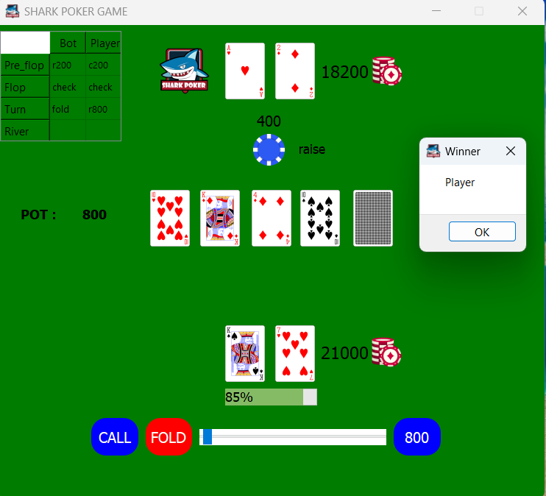
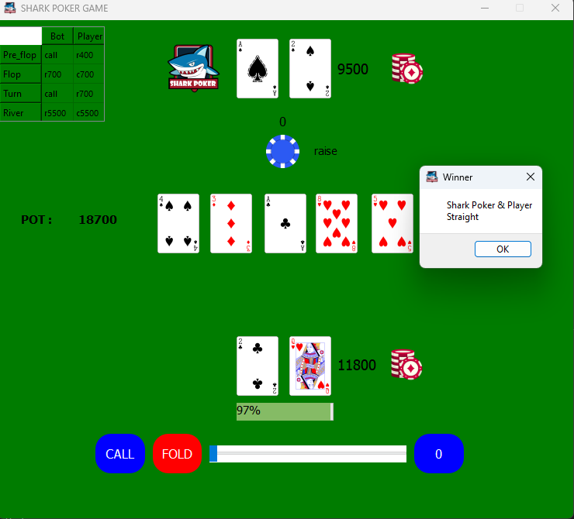

Slide 15
